Slide 1
PILOT
REVIEW
DECISION PENDING
Source: Synthetic pilot brief
Notes:
Introduce the pilot review presentation. State clearly up front that final operational decisions remain pending review of completed performance data.

Slide 2
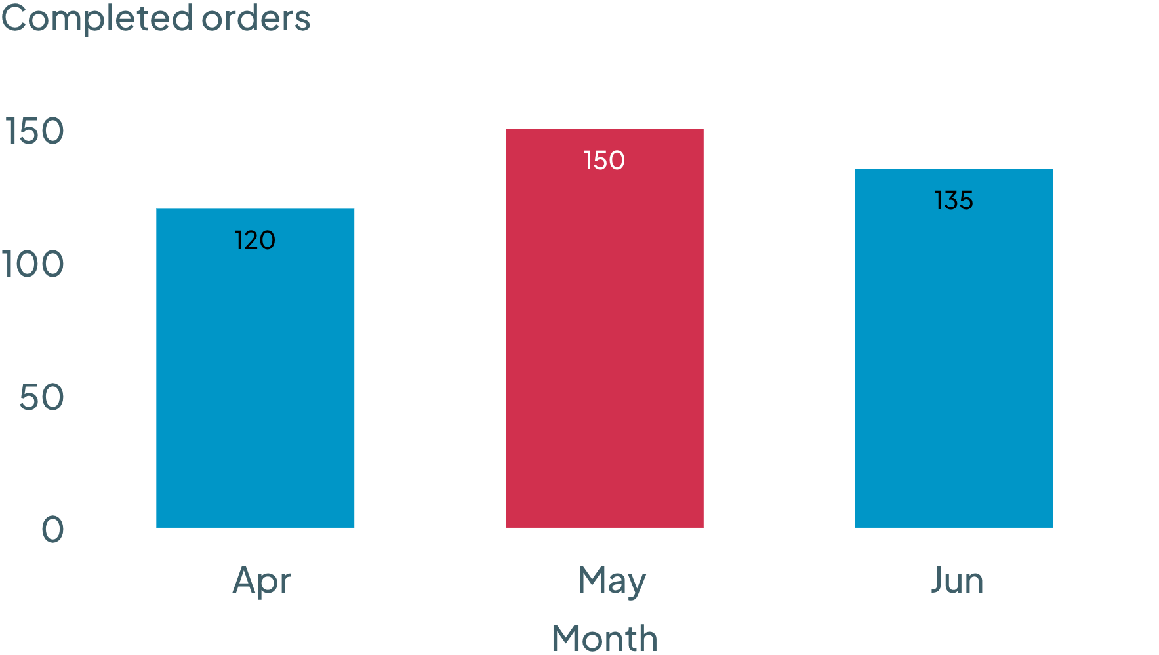
QUARTERLY VOLUME
405
completed orders across April–June
MONTHLY COMPLETED ORDERS
COMPLETED ORDERS BY MONTH
May had the most completed orders of the three months.
MONTH | COMPLETED ORDERS
April | 120
May | 150
June | 135
Total | 405
Source: Synthetic pilot brief
02
Notes:
Walk through the quarterly volume breakdown. Review April through June performance, highlighting May as the peak month with 150 completed orders and a cumulative total of 405 orders.

Slide 3
FORWARD PLANNING
July target remains unapproved
PRIMARY RISK
REQUIRED ACTION
JULY TARGET NOT APPROVED
SEEK APPROVAL BEFORE COMMITMENT
The July volume baseline has not received formal sign-off. Operational commitments cannot be locked until authorized targets are confirmed.
Seek approval of a July target before treating one as committed. Align leadership on capacity expectations prior to executing the next phase.
Source: Synthetic pilot brief
Source: Synthetic pilot brief
03
Notes:
Address the governance risk and immediate next steps. Reiterate that no July volume assumption should be treated as committed until formal target approval is obtained.

