Slide 1
PILOT
REVIEW
DECISION PENDING
Source: Synthetic pilot brief
Notes:
Introduce the pilot review presentation. State clearly up front that final operational decisions remain pending review of completed performance data.

Slide 2
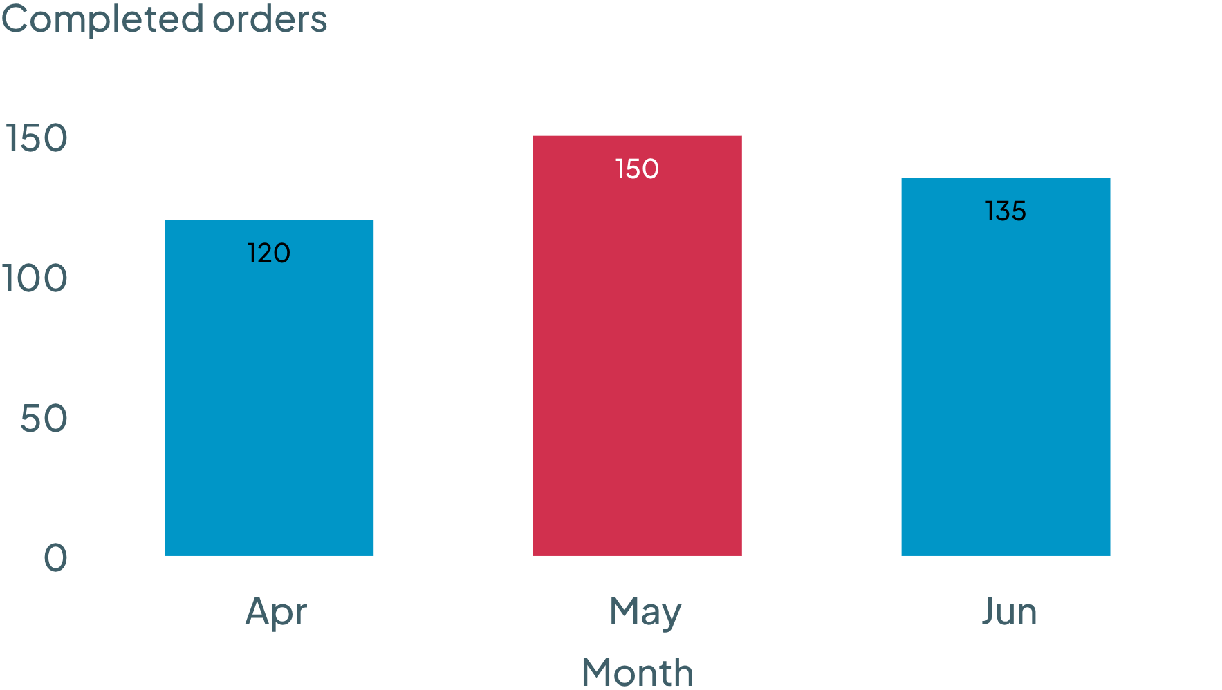
QUARTERLY VOLUME
405
completed orders across April–June
MONTHLY COMPLETED ORDERS
COMPLETED ORDERS BY MONTH
May had the most completed orders of the three months.
MONTH | COMPLETED ORDERS
April | 120
May | 150
June | 135
Total | 405
Source: Synthetic pilot brief
02
Notes:
Walk through the quarterly volume breakdown. Review April through June performance, highlighting May as the peak month with 150 completed orders and a cumulative total of 405 orders.

Slide 3
FORWARD PLANNING
July target remains unapproved
PRIMARY RISK
REQUIRED ACTION
JULY TARGET AWAITING MANAGEMENT APPROVAL
SEEK APPROVAL BEFORE COMMITMENT
Seek approval of a July target before treating one as committed. Align leadership on capacity expectations prior to executing the next phase.
The July target is awaiting management approval. Operational commitments cannot be locked until the target is approved.
Source: Synthetic pilot brief
Source: Synthetic pilot brief
03
Notes:
Address the governance risk and immediate next steps. Reiterate that no July volume assumption should be treated as committed until formal target approval is obtained.

